Slide 1
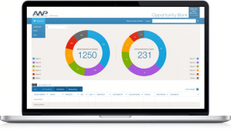
AWP CRM Dashboards
The Challenge
One of the country's leading food service brokerages, Advantage Waypoint (AWP), was looking to gain a competitive advantage by empowering team members to quickly consume information about, and collaborate together on, business opportunities, thereby improving overall productivity and efficiency.
What We Did
Designed and developed an internal CRM tool which dynamically displayed information from disparate systems
Role based views designed to accommodate business needs
Relevant AWP users are able to change the status of opportunities to close, thereby realizing revenue faster and improving sales efficiency
Results

